Slide 1
Network Forensics
By: Abdullah Lababidi, Elijah Boyak, Lindsay Kreslake, Michael Dodge, Nathan Santos, and Kyle Carey

Slide 2

Table of Contents
This document contains the following resources:
Traffic Profile
Normal Activity
Malicious Activity

Slide 3
Traffic Profile

Slide 4
Traffic Profile
Our analysis identified the following characteristics of the traffic on the network:
Feature | Value | Description
Top Talkers (IP Addresses) | 172.16.4.205 185.243.115.84 166.62.111.64 | Machines that sent the most traffic.
Most Common Protocols | TCP, UDP, HTTP, DNS | Three most common protocols on the network.
# of Unique IP Addresses | 810 | Count of observed IP addresses.
Subnets | 172.217.0.0/16 205.251.192.0/16 216.239.32.0/8 | Observed subnet ranges.
# of Malware Species | 1 | Number of malware binaries identified in traffic.
Notes:
You may have more than 2 subnets.

Slide 5
Behavioral Analysis
Purpose of Traffic on the Network
Users were observed engaging in the following kinds of activity.
“Normal” Activity
Using google to search for various things online.
Users were reading the news.
Users were shopping online.
Users were wasting time watching Youtube videos.
Suspicious Activity
Some users have also been heard of torrenting on the network. Although not forbidden is the use of torrents for legitimate purposes such as downloading operating systems, there is a strict policy against copyright infringement.
A number of machines with foreign subnets are repeatedly sending traffic to the network.
Repeated sent traffic from Top Talkers could indicate a possible attempted DoS attack.
Reports came in of an infected windows host on the network.

Slide 6
Normal Activity

Slide 7
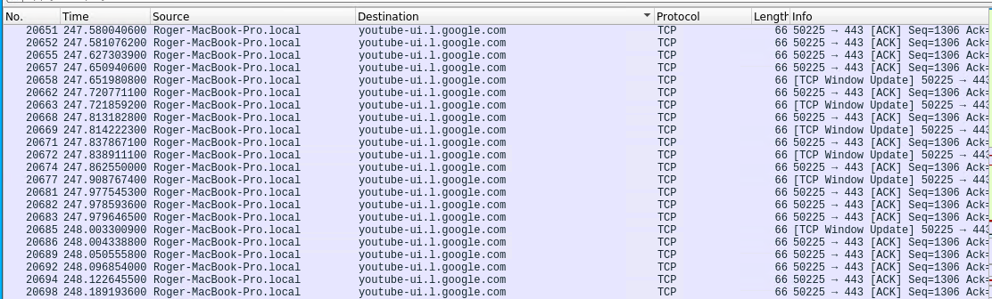
Accessing Youtube Website
Summarize the following:
What kind of traffic did you observe? Which protocol(s)?
ACKs to acknowledge Traffic Layer Security encrypted application data traffic from youtube.
Protocol is Transmission Control Protocol (TCP).
What, specifically, was the user doing? Which site were they browsing? Etc.
Traffic between Roger-Macbook-Pro.local and youtube-ui.l.google.com
Screenshot:

Slide 8
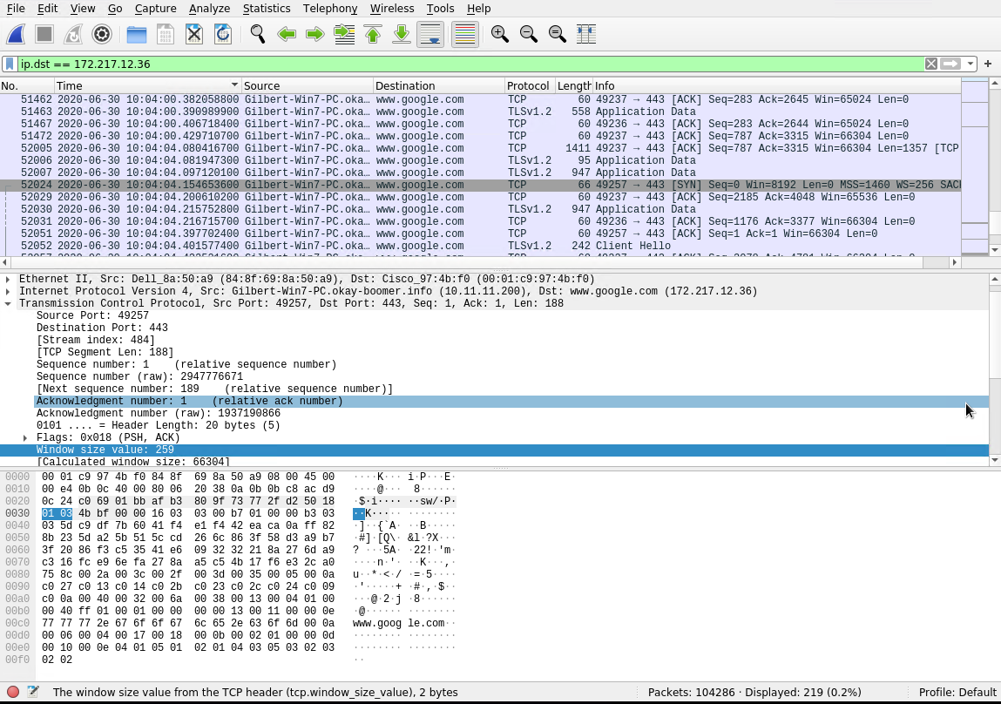
Use of Google to search
Summarize the following:
Users used google to search for various things both work and non-work Related
These searches use both UDP and TCP connections
One user was using google to find Data Analytics tools. The one they found was the site Fullstory.com.

Slide 9
Malicious Activity

Slide 10
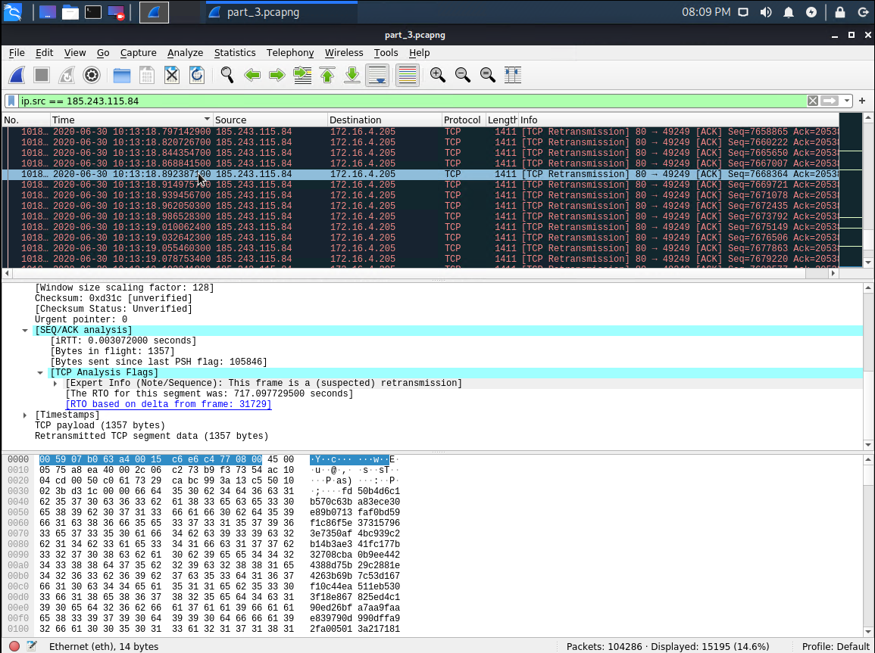
TCP Retransmissions
The activity is flagged as tcp retransmission by wireshark.
The TCP retransmission mechanism ensures that data is reliably sent from end to end. If retransmissions are detected in a TCP connection, it is logical to assume that packet loss has occurred on the network somewhere between client and server, But also identical to the connections sent before.
The malware on the machine, "june11.dll”, is repeatedly sending identical requests over and over again abusing the TCP Retransmission mechanic.

Slide 11
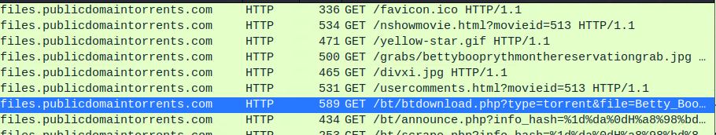
Illegal Downloading
Elmer Blanco uses AD domain to discreetly torrent
What kind of traffic did you observe? Which protocol(s)?
Observed illicit downloads of torrents using HTTP protocol
Coming from Win user elmer.blanco
What, specifically, was the user doing? Which site were they browsing? Etc.
User browsed “public domain torrents” and downloaded various files
Include a description of any interesting files.
Torrented movie ~ Betty Boop Rhythm on the Reservation
Also downloaded various pictures

Slide 12
The End!

